Slide 1
Factory Method Pattern
Design Patterns

Slide 2


Problem Definition
Imagine that you’re creating an e-Commerce web application. The first version of your app can only sell Books, so the bulk of your code lives inside the Book class. After a while, your app becomes pretty popular. Each day you receive dozens of requests from customers about selling Toys ( or another kind of product).
Good News ! But …
Most of your code is coupled to the Book class. Adding Toy into the app would require making changes to the entire codebase. Moreover, if later you decide to add another type of product to the app , you will be facing with making all of these changes again !
At the end, you will end up with “nasty” code, riddled with conditionals that switch the app’s behavior depending on the class of product objects.
Your Online Book Store

Slide 3
Solution
The the reason of the problem here is; traditionally we create objects using their exact classes , such as a Book class or Toy class. If we beat around the bush and use a factory method outside to create “products” without specifying the “extact type of the product“ we can handle the situation!
How :
We use an abstract class or an interface to represent the basic common attributes and the functionality of our “exact types”. Then we implement the interface or inherit the abstract class in our “concrete classes”. In our case this interface/ abstract class is “Product” and our concrete classes are “Book and Toy”
Then we create a factory method outside the product structure and use this to create “Product type” objects but the exactly the one we need !

Slide 4
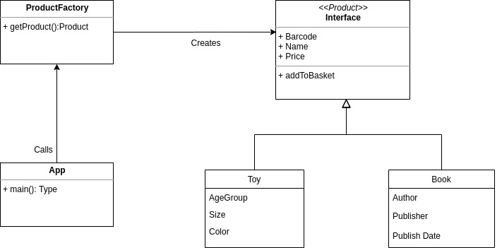
Implement

Slide 5
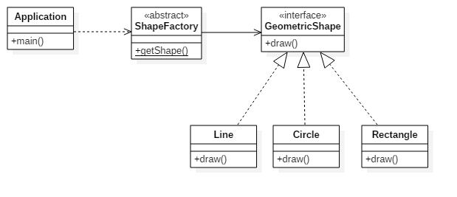
Basic Classic Example : Shape

Slide 6
Basic Classic Example : Shape
Open the Eclipse

Slide 7
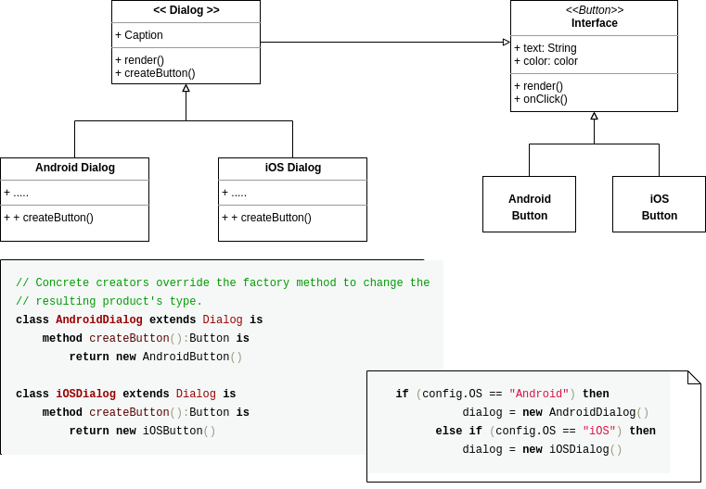
A more complicated example : cross-platform UI
Creating cross-platform UI elements without coupling the client code to concrete UI classes :
A button is a button for every OS , so we can use a button interface as a “product” and OS dependent COncrete classes.
The factory method here is in the dialog abstract class , and we override it in os dependent dialog classes.

Slide 8
When to Use
Use the Factory Method when you don’t know beforehand the exact types and dependencies of the objects your code should work with.
The Factory Method separates product construction code from the code that actually uses the product. Therefore it’s easier to extend the product construction code independently from the rest of the code.
For example, to add a new product type to the app, you’ll only need to create a new creator subclass and override the factory method in it.

Slide 9
Pros - Cons
You avoid tight coupling between the creator and the concrete products.
Single Responsibility Principle. You can move the product creation code into one place in the program, making the code easier to support.
Open/Closed Principle. You can introduce new types of products into the program without breaking existing client code.
The code may become more complicated since you need to introduce a lot of new subclasses to implement the pattern. The best case scenario is when you’re introducing the pattern into an existing hierarchy of creator classes.

